Slide 1


Slide 2



AI VS AI
By
Abdallah Mamdouh Fathy (20200308)
Abdelhamid Adel Abdelhamid (20200275)
Hagar Mohammed Hassan (20201205)
Tasneem Yaser Al-Maghawry (20201047)
Waad Ragab Barakat (20201216)
Zaineb Gamal Mohammed (20200811)
Supervised by
Dr. Mohammed Wahby
TA. Asmaa Ahmed

Slide 3
Agenda: Detecting AI-Generated Images
01
Project Idea
02
Problem Significance
03
Project Specifications
04
Results
05
User Interface
06
Conclusion

Slide 4


01
Project Idea

Slide 5
Introduction
AI vs AI: Can AI overcome itself?
In digital age, everyday countless of fake images are generated by AI. How can AI face this challenge?
Project Idea
The use of AI to detect AI-generated images.
The project aims to develop a system for detecting AI-generated images and provide a way to distinguish them from real images.

Slide 6

02
Problem Significance

Slide 7
Problem Statement:
AI Generators produce realistic content that are indistinguishable from
real one.
The risks of misinformation, manipulation, and unethical purposes.
AI-generated content can be used to manipulate public opinion, deceive individuals, and do various forms of cybercrime.
Fake images can be used to harass or bully individuals, causing psychological harm sometimes leads to suicide.

Slide 8










Why?
Percentage of propagation of the AI-generated content

Slide 9
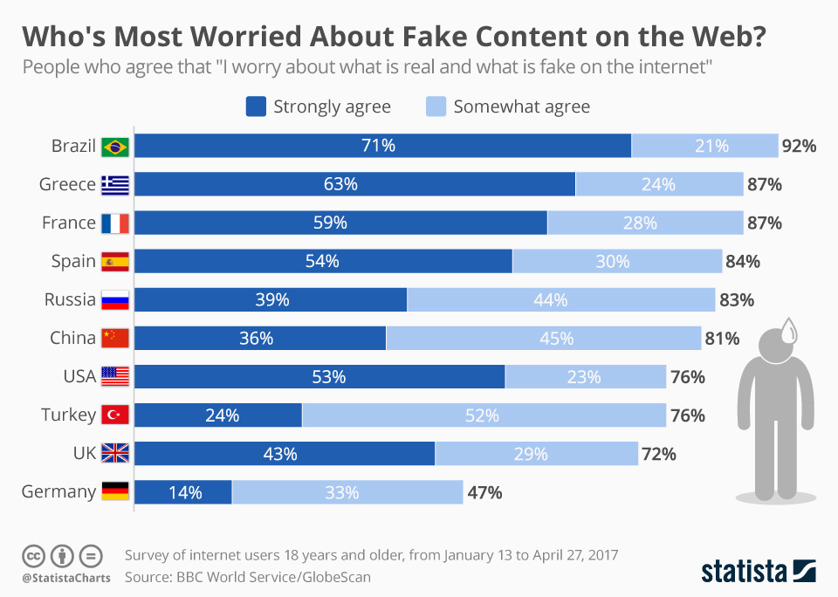
Why?
People who agree that “ I worry about what is real and what is fake on the internet”

Slide 10

03
Project
Specifications

Slide 11
Literature Review
Previous Works
1.Detecting-Images-Generated-by-Diffusers: (2023)
Considering two starting datasets, namely MSCOCO and Wikipedia Image-Caption Matching dataset with a total of 27k images for each one.
A significant generalization issue exists. The model trained on Stable Diffusion-generated images can detect GLIDE-generated images, but the reverse is not true.
On the MSCOCO training on SD and testing on GLIDE achieves 69.7% accuracy, the reverse scenario 52.3%
2. Online Detection of AI-Generated Images: (2023)
Dataset is composed of 570,221 images.
Dataset of 14 well-known generative models using different generating architecture and released between June 2020 and March 2023, and LAION-400M as a source of non-generated images.
ResNet-50 pre-trained on ImageNet is used to simulate the online training in the sequence that continues from the previous model weights.

Slide 12
Literature Review
Similar Products
Product | Generators | Limitations
AI or Not | GAN Stable Diffusion Midjourney DALL-E2 Generated faces | Support only PNG and JPEG images
Is it AI | Not mentioned | Inaccurate at low-quality and heavily manipulated images. Confused with real images contains features similar to those found in generated images.
DALL-E
Stable Diffusion
Midjourney
Content at
Scalet
Not mentioned

Slide 13
Literature review
Challenges & Limitations
Supporting specific image format
Generalization Problem:
Low performance of the detectors on the fake images that are generated by unseen generating-models in the training phase.

Slide 14

What’s new in
AI vs AI?

Slide 15
New Improvements:
Enhance the performance of the model to has more accurate and reliable results.
Improve the generalization by training the model on a dataset contains 25 generators includes 13 GANs based, 7 Diffusion based, and 5 other miscellaneous generators.
Enhance our fake image recognition system's accuracy in detecting fake faces, by developing a specialized model to work alongside the general one.

Slide 16

Methodology

Slide 17
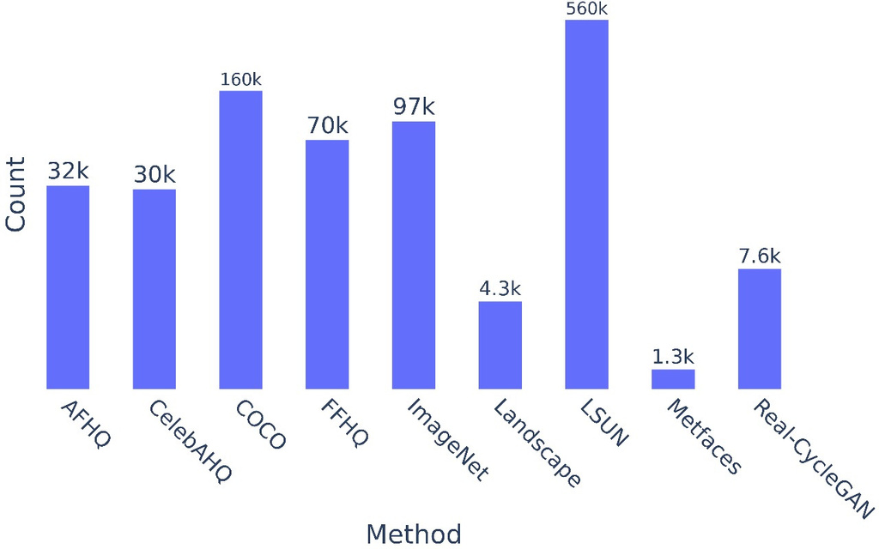
Dataset
In this section, we outline the process for developing a generalized model to detect AI-generated images. Our approach involves a combination of data collection, feature extraction, and deep learning techniques to ensure accurate identification.
To address the limitations identified in previous approaches and improve model generalization, a diverse dataset of both real and AI-generated images will be used- named ArtiFact.
Dataset Description:
Total number of images : 2,496,738 images .
Number of real images: 964,989 images.
Number of fake images: 1,531,749 images .
Number of sources used for real images: 8.

Slide 18
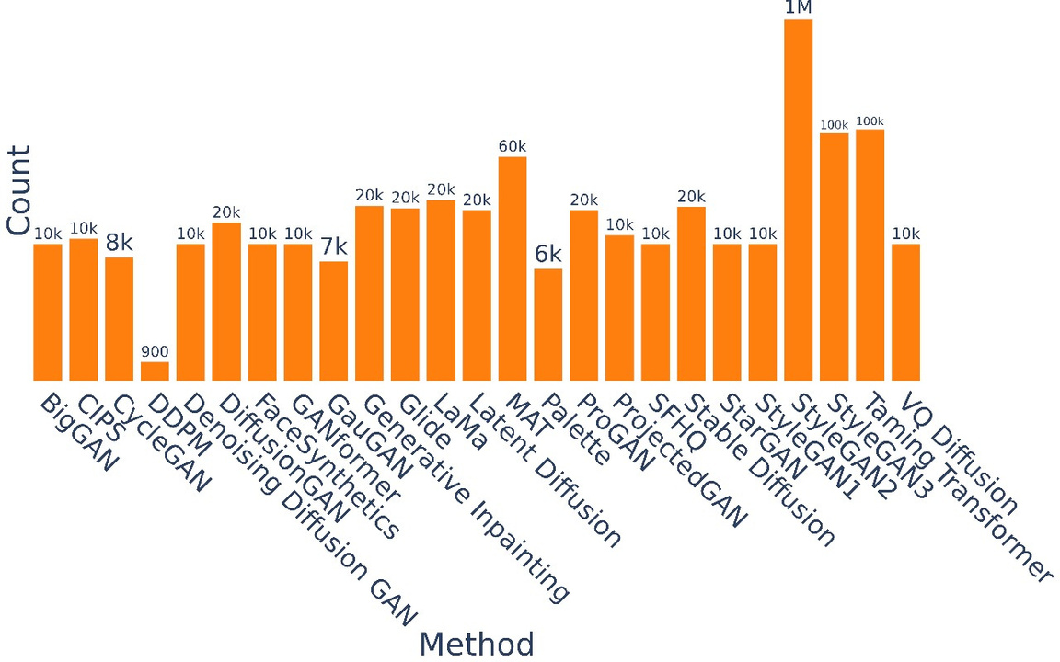
Dataset Description:
Number of generators used for fake images: 25 (including 13 GANs, 7 Diffusion, and 5 miscellaneous generators).
Categories included in the dataset: Human/Human Faces, Animal/Animal Faces, Places, Vehicles, Art, and other real-life objects: 8. .
Image Resolution: 200×200

Slide 19
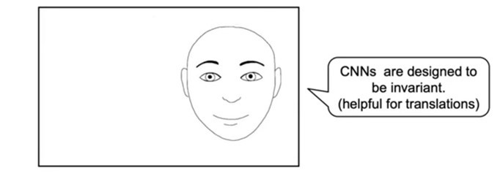
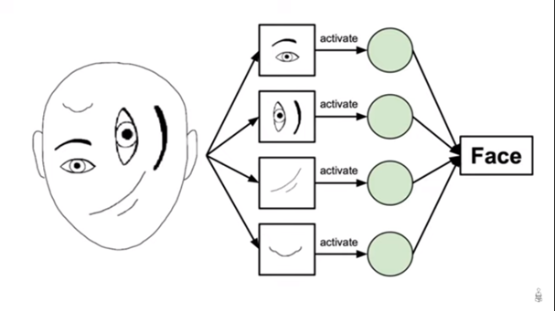
Model
Capsule Network:
Why not traditional CNN:
Invarinace vs Equivariance
CNNs do not encode pose and angular information.

Slide 20
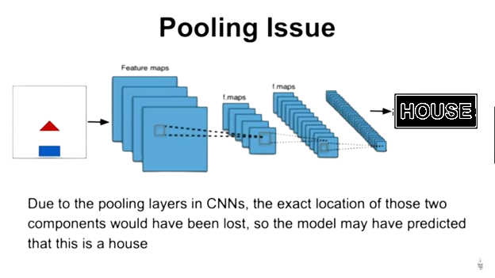
Model
Why not traditional CNN:
Pooling issue
ConvNets perform routing via pooling layers, Due to the pooling layers in CNNs, the exact location of those two components would have been lost, so the model may have predicted that this is a house

Slide 21
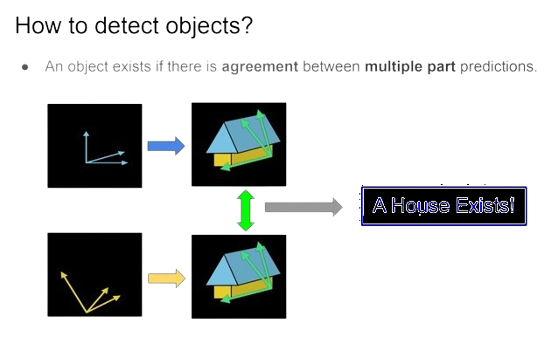
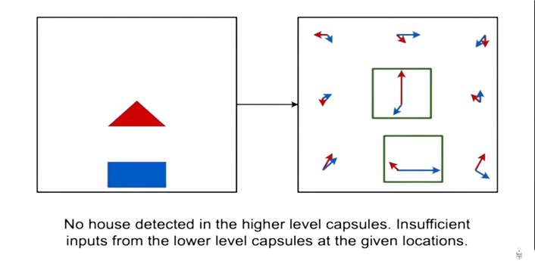
How to detect objects?
An object exists if there is agreement between multiple part predictions.
Capsule Network:
How to work in this vector format?
In the vector, the angle of the vector is the properties and the length is the probability of its existence.

Slide 22
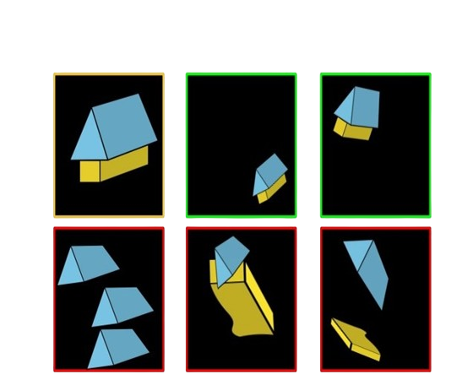
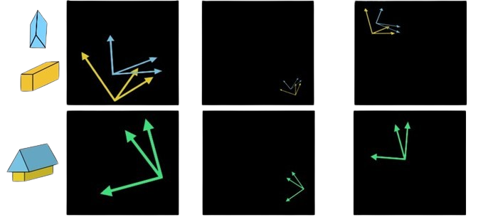
Viewpoint Equivariance:
• How can we handle different viewpoints?

Slide 23
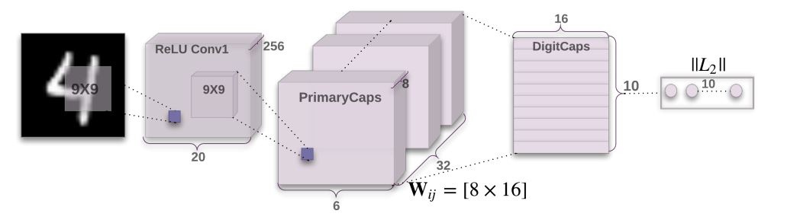
Capsule Network:
First Layer: CNN
Two convolutional layers
and one fully connected layer
Consists From Conv1D Layer having 256 filters each 9 × 9 kernel, stride 1 and
ReLU Activation.
Responsible for converting raw pixel intensities from the input image into feature maps.
Second Layer: Primary Capsule
Primary capsule contains 8 convolutional units with a 9 × 9 kernel and a stride of 2 with 32 channels.

Slide 24
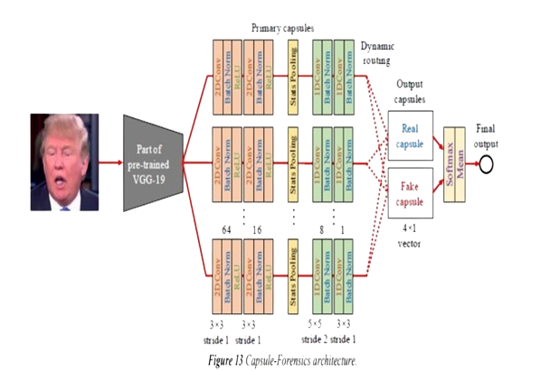
Model Design Phase
Overview of our model architecture

Slide 25
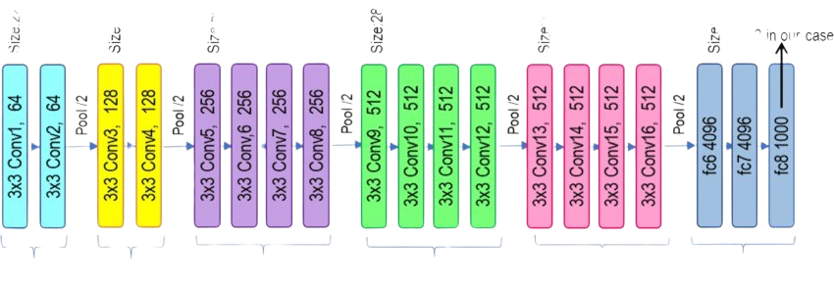
Model Design Phase
First Layer: VGG
Utilizing part of the pre-trained VGG-19 which trained on ImageNet dataset, instead of the convolutional part in the original Capsule architecture (First 10 layers).
It's used as a feature extractor.
Why we use subset of pre-trained VGG-19?
The early layers of VGG-19 capture basic and mid-level features such as edges, textures, and simple patterns, going deeper into the network would capture more specific and complex features, which might introduce biases related to the original object detection task the network was pre-trained on.

Slide 26
Model Design Phase
First Layer: VGG
Why we use Pre-trained VGG-19 instead of CNN Part?
-Enhanced Feature Extraction:
Leading to better performance in capturing complex patterns and details in
the images compared to a simpler architecture.
-Transfer Learning:
Taking a model that has been pre-trained on a large dataset and fine-tuning it for a different but related task, this uses the rich pre-learned features instead of starting from scratch.
-This can significantly reduce the amount of data and time needed to train the model.
-Improve model performance:
These weights provide a good starting point for model training.

Slide 27
Model Design Phase
Second Layer: Primary Capsule
Block 1: Consists From Conv2D Layer having 64 filters each 3x3 kernel, stride 1 and padding 'same' followed by BatchNormalization Layer and ReLU Layer.
Block 2: Consists From Conv2D Layer having 16 filters each 3x3 kernel, stride 1 and padding 'same' followed by BatchNormalization Layer and ReLU Layer.
Block 3: Consists From Custom Layer 'StatsPooling':
reshape the height and width to be one dimension then get the average and standard deviation, this help making the model independent of the image size.

Slide 28
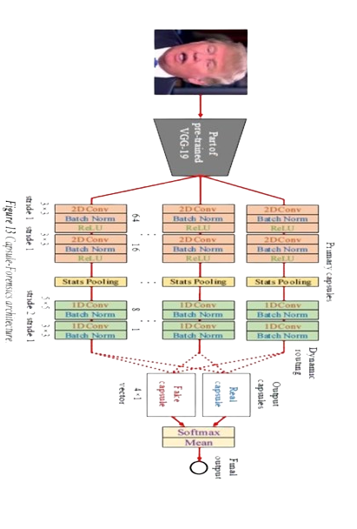
Model Design Phase
Second Layer: Primary Capsule
Block 4: Consists From Conv1D Layer having 8 filters each 5x5 kernel, stride 2 and padding 'same' followed by BatchNormalization Layer
Block 5: Consists From Conv1D Layer having 1 filters each 3x3 kernel, stride 1 and padding 'same' followed by BatchNormalization Layer

Slide 29
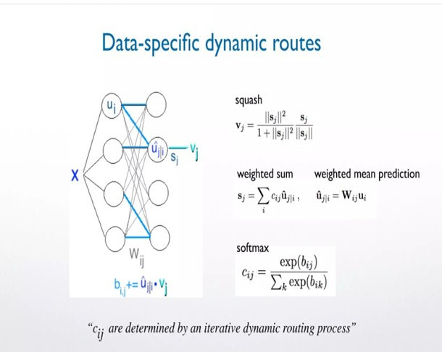
Model Design Phase
Third Layer: Dynamic Routing
The dynamic routing algorithm is used to calculate agreement between the features extracted by the primary capsules
The agreements between low- and high-level capsules that encode the hierarchical relationships between objects and their parts with pose information enables a capsule network to preserve more information than a CNN while using only a fraction of the data used by a CNN.

Slide 30
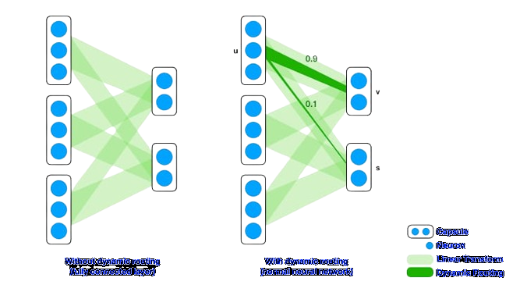
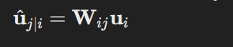
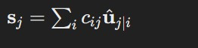
Model Design Phase
Third Layer: Dynamic Routing
Routing By Agreement Process:
Making Predictions
Iterative Agreement Process:
-Initial Routing Coefficients set to be equal
-Calculating the Raw Weighted Input

Slide 31
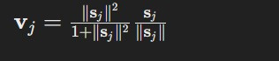
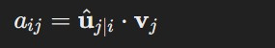
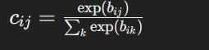
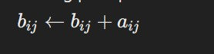
Model Design Phase
Third Layer: Dynamic Routing
Routing By Agreement Process:
-Applying the Squashing Function
-Calculating Agreement
-Updating Routing Coefficients

Slide 32
Model Design Phase
Third Layer: Dynamic Routing
Routing By Agreement Process:
This process iterates several times to refine the routing coefficients based on agreement.
Final Output of Higher-Level Capsules
After the iterative routing process we have 2 final output vector:
real capsule and fake capsule

Slide 33
Model Design Phase
Fourth Layer: Output Capsule
Real Capsule : Encodes features representing real images.
Fake Capsule: Encodes features representing fake images.
To calculate predicted label yˆ, we apply the softmax function to each dimension of the output capsule vectors to achieve stronger polarization rather than simply using the length of the output capsules . The final results are the mean of both real capsule and fake capsule after applying softmax

Slide 34
Training Phase
Our model architecture parameters
10 primary capsules
Dropout with a rate of 0.3.
2 iterations were used in the dynamic routing algorithm to enhance the model's robustness and accuracy

Slide 35
Training Phase
Dataset and Training Setup
Using artifact dataset comprising fake images from 25 different generators, covering comprehensive categories to ensure a robust and representative sample. The total dataset included 1,936,738 samples, with 20% reserved for testing.
We used sparse categorical cross entropy loss function as our loss function.
This choice was driven because the classification task's labels are provided as
binary with sigmoid activation function.
The optimizer selected was Adam.
We chose this optimizer because it is known for adapting the learning rate during training and effectively handling sparse gradients.

Slide 36
Training Phase
Hyperparameters
The training process utilized a learning rate of 1e-4 ensuring optimal convergence and performance.
We employed a learning rate decay schedule to reduce the learning rate over time, preventing overshooting the optimal solution.
We experimented with various hyperparameters and finalized the following settings:
- Batch Size: 32 and 128
Combining the benefits of small and large batch sizes allows for a balanced trade-off between fast, frequent updates (batch size 32) and stable, accurate updates (batch size 128), and balance between explore & exploit
- Number of Epochs: 17 epochs.

Slide 37
Training Phase
Challenges and Solutions:
Data Imbalance
Our dataset had an uneven distribution of classes, leading to a biased model that
favored the majority class [Fake], this issues solved by provide Undersampling techniques to reduce instances of the majority class
Long Training Times:
Training the model was taking an excessive amount of time due to the complexity and size of the dataset. the solution was utilizing GPUs for faster computation and parallel processing capabilities. In addition we had experimented with different batch sizes to find an optimal balance between training speed and model performance.

Slide 38
Training Phase
Challenges and Solutions:
Vanishing Gradient:
Gradients either became too small during backpropagation, causing the model to train poorly and causing not a number [NAN] loss. we overcame this challenge by using Gradient Clipping, Applied gradient clipping to restrict the gradients to a certain range, preventing them from becoming too large beside the normalization layers and learning rate schedule.
Hyperparameters tuning:
Tuning the hyperparameters was very challenging as it was costing, we tried providing the possiable resources purchasing online platform services (ColabProPlus)

Slide 39

04
Results

Slide 40
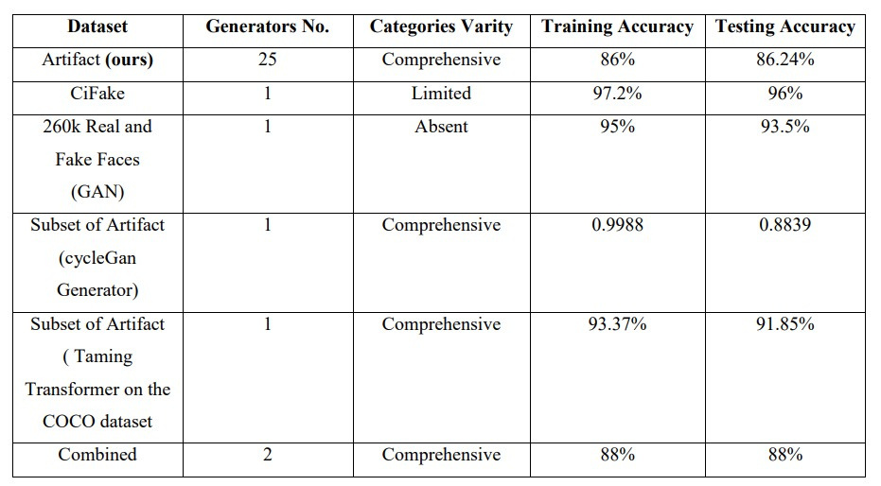
Results
Results Of Capsule Model on different Datasets

Slide 41
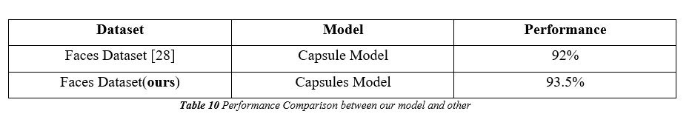
Results
Performance Comparison between our model and other

Slide 42

05
User Interface

Slide 43
User Interface
The website’s structure and styling achieved using HTML and CSS, ensuring a clean, accessible, and aesthetically pleasing design. Bootstrap was integrated to guarantee a responsive design and a consistent look across various devices, thus enhancing the overall user experience.
JavaScript was employed to introduce interactive elements, making the interface more dynamic and engaging.
The backend of the website is powered by Flask.
To provide faster responses, we also offer a caching service for previously checked images.

Slide 44

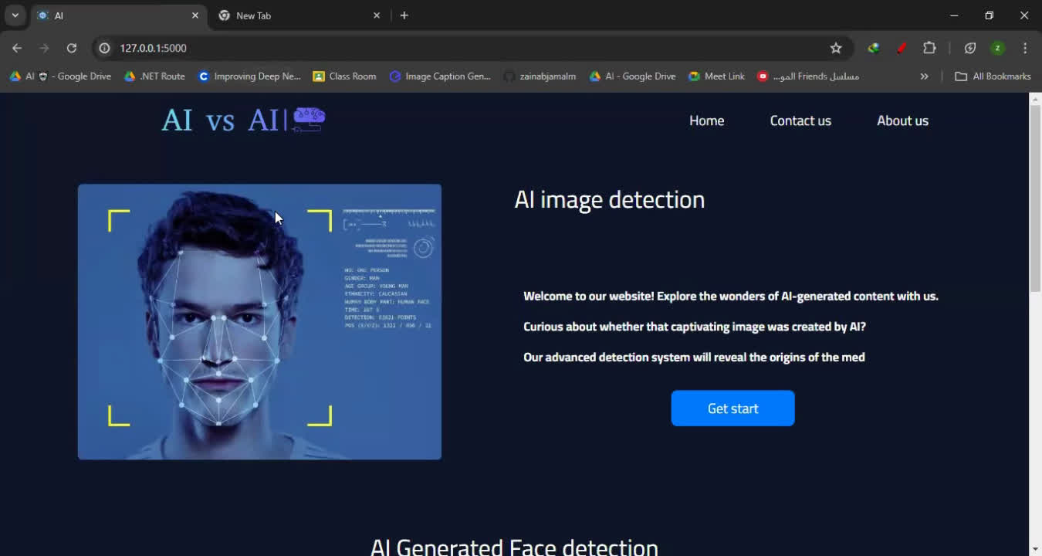
User Interface
Website Demo:

Slide 45

06
Conclusion

Slide 46
Conclusion
Developed an AI Image Detection Platform using Capsule Networks to accurately identify fake images.
Capsule Networks were chosen for their superior ability to capture hierarchical relationships within data, beneficial for detecting subtle differences between real and AI-generated images.
Model Performance was enhanced:
-Improved the model's ability to generalize across different contexts and image types.
-Leveraged transfer learning from pretrained models.
Developed an AI Image Detection Platform as a website to ensure ease of use for users.
Faster responses were provided, we also offered a caching service for previously checked images.

Slide 47
Future Work
We aim to enhance our model by incorporating confidence scores for each prediction. This means not only providing a binary classification (real or fake) but also a probability score that indicates the model's confidence in its prediction.
We plan to extend our current image-based model to handle video data. This involves creating algorithms that can analyze each frame of a video and detect if any part of the video has been manipulated.
Improving the model's accuracy ensures that the model is more reliable and effective in detecting fake images, minimizing errors, and increasing the overall robustness of the detection system.
Deploy our model on a publicly accessible website, moving beyond a local host setup.

Slide 48


